Slide 1
Connecting Mongo DB Database using Express js with mongoose – Step 10

Slide 2
Frist create the folder structure
Backend folder
Open this folder in vs code
Create package.json file using the command as npm init
Install created dependencies like
npm install express
npm install mongoose
npm install cors

Slide 3
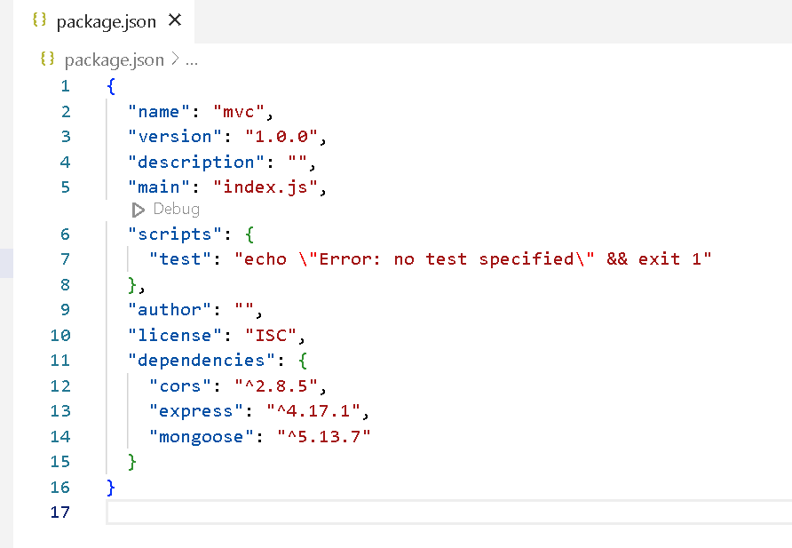

Slide 4
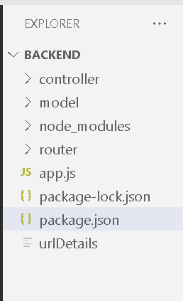
Now create the folder structure

Slide 5
Create the model file as productModel.js
This file hold the schema details like collection name, number of fields required inside that collection with their data types.
And this model need to export so in another file we can import it.

Slide 6
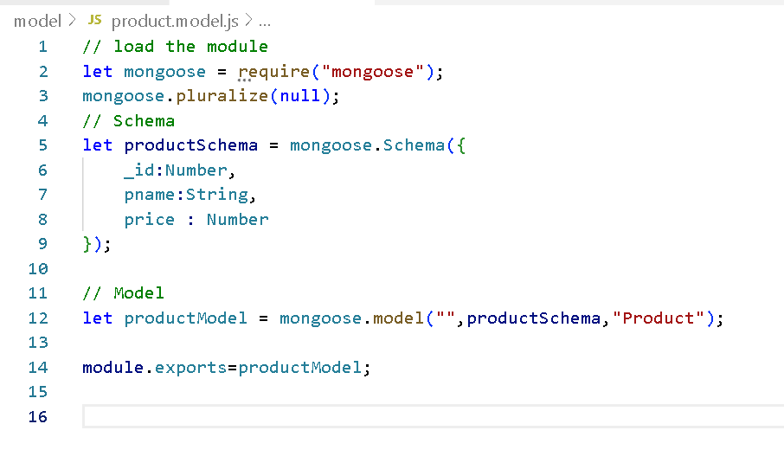

Slide 7
Now we need to create controller file
This file contains more than one methods and which takes request and response as a parameter and it will import the model and base upon the client request it will do the operation on model which link with mongo db collection. Like
Get : to get all product details or get specific product details base upon the any field.
Post : to store product information
Put : to update the product price using product id.
Delete : to delete the product details using product id

Slide 8
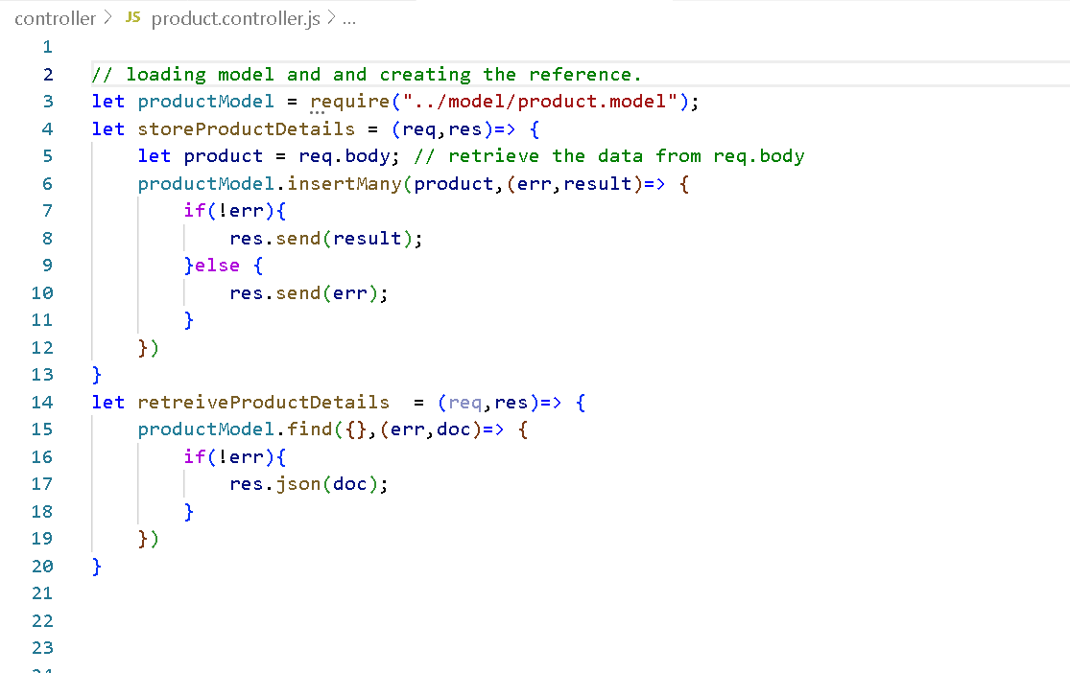

Slide 9
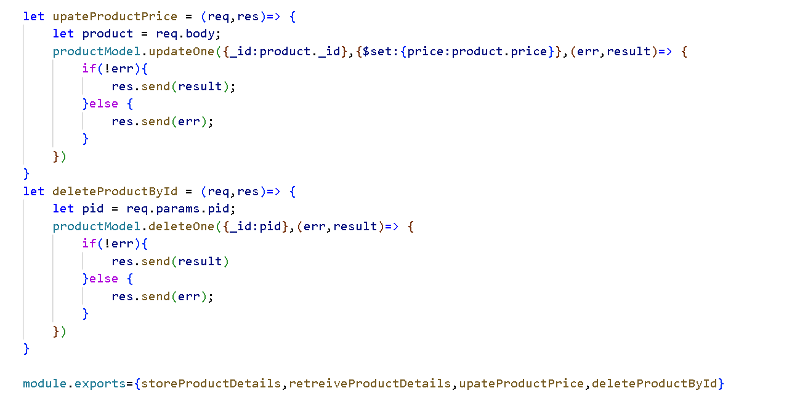

Slide 10
Now we need to create router file
This file is use to route the request.
It will check sub path of the request and http method and base upon client request it will re direct to specific controller methods.
This is centralize file which help to keep the track about the all operation doing on product entity.

Slide 11
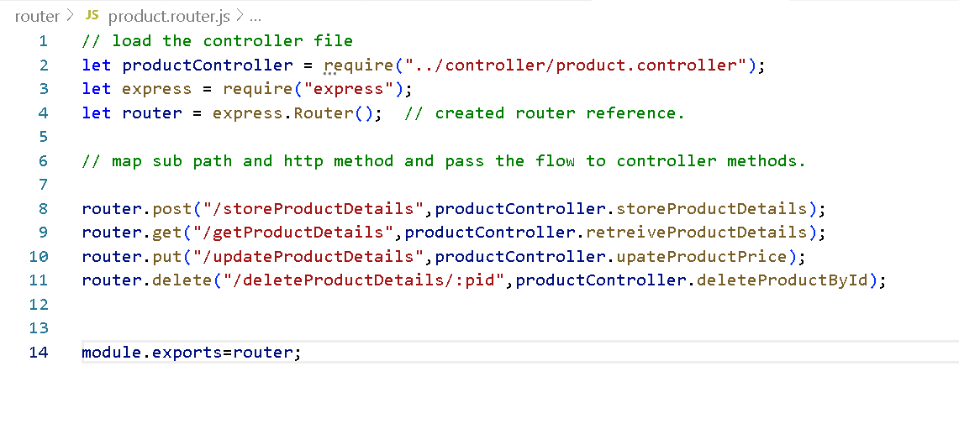

Slide 12
Now we will create the app.js file
This is main file
This file load all the required module like express, mongoose, cors.
Create the reference of express.
All middleware base upon the requirement like enable cors policy which help to call frontend technologies.
Then add router as a middleware
Then run the application on specific port number like 9090 or 3000

Slide 13
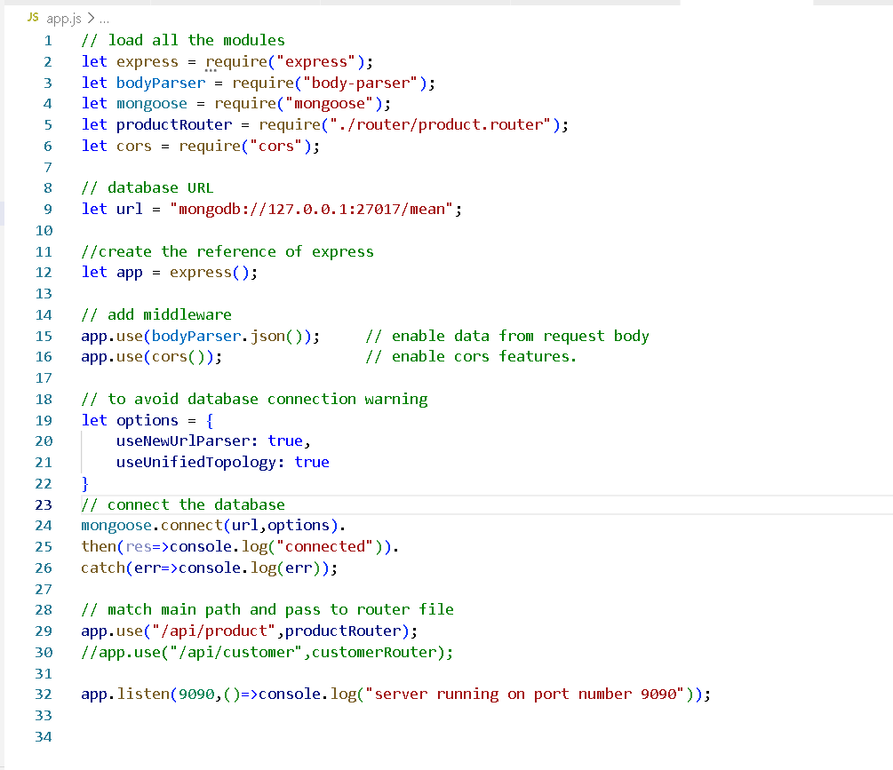

Slide 14
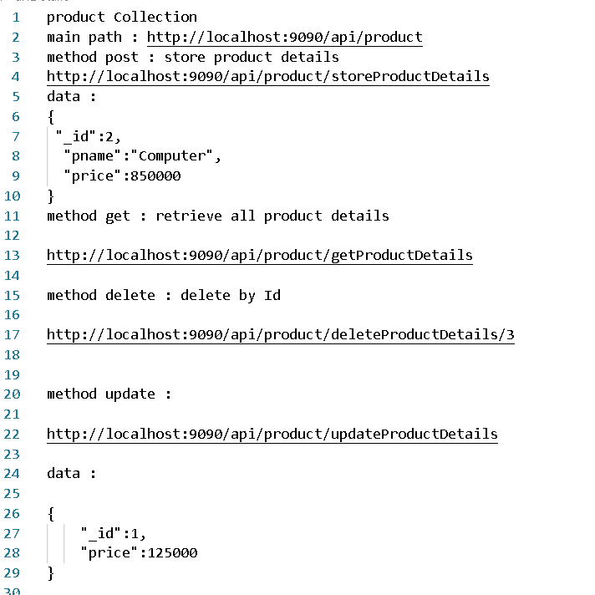
All rest api url reference file

Slide 15
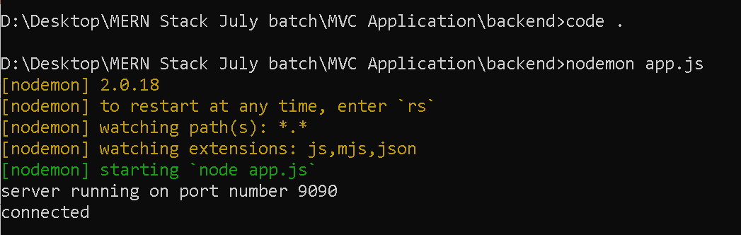
Now run the app.js file using command prompt- store more documents.

Slide 16
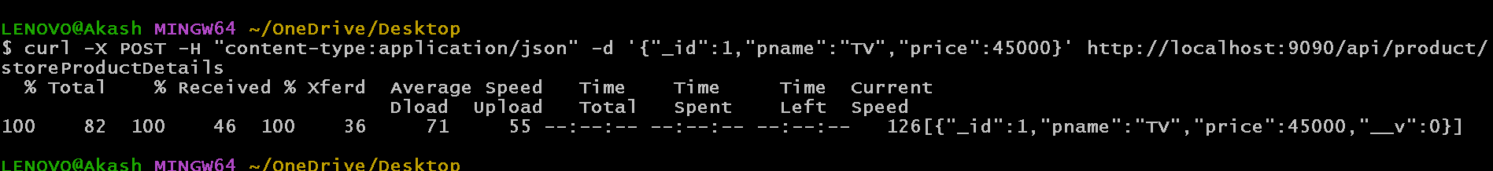
Now open the Git terminal
To store the product
curl -X POST -H "content-type:application/json" -d '{"_id":1,"pname":"TV","price":45000}' http://localhost:9090/api/product/storeProductDetails

Slide 17
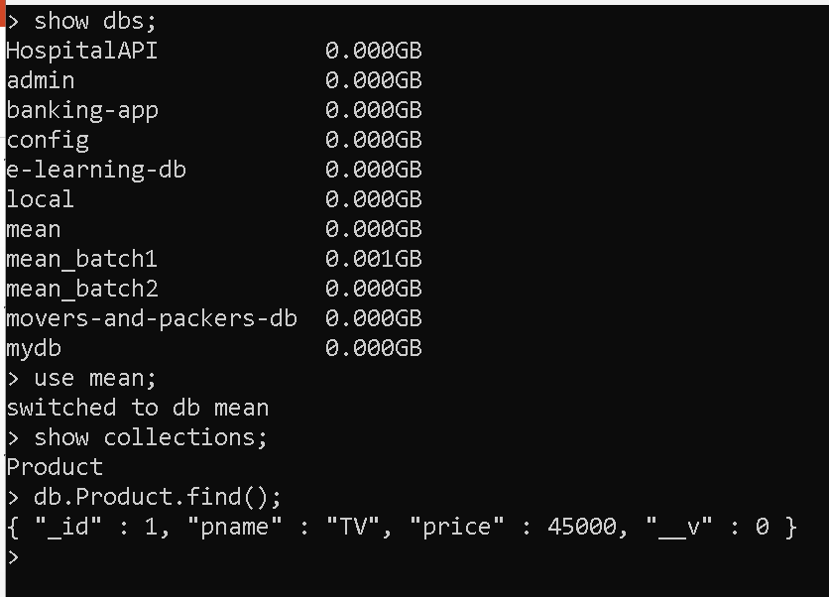
In Mongo db database mean db created and you can check product collection

Slide 18
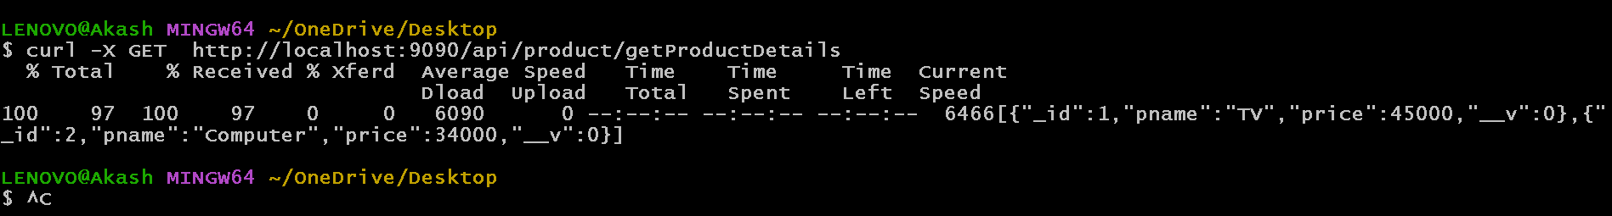
View all documents from product collection
curl -X GET http://localhost:9090/api/product/getProductDetails

Slide 19
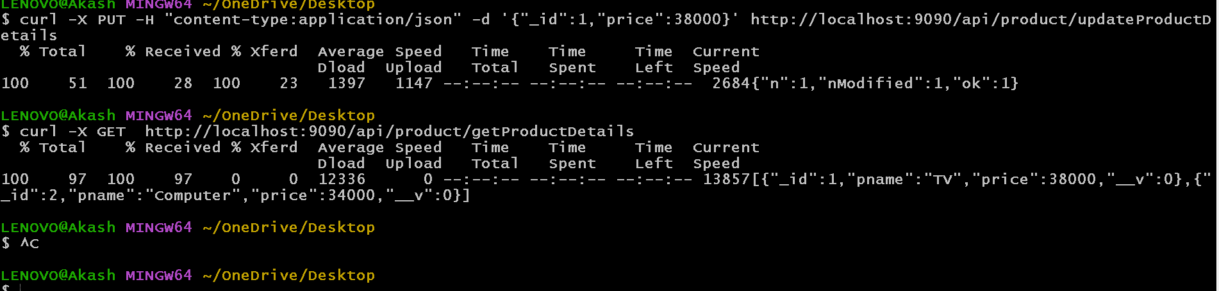
Update the price using _id value in product document.
curl -X PUT -H "content-type:application/json" -d '{"_id":1,"price":38000}' http://localhost:9090/api/product/updateProductDetails

Slide 20
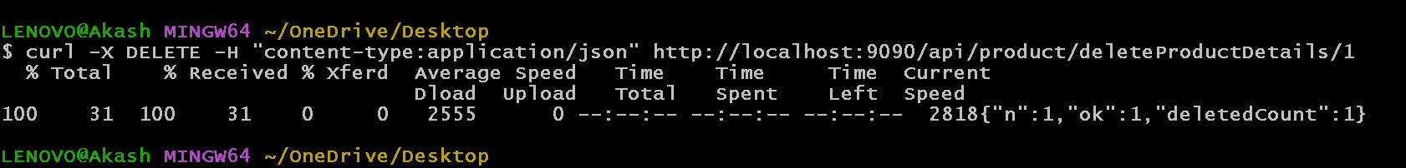
Delete product information using _id
curl -X DELETE -H "content-type:application/json" http://localhost:9090/api/product/deleteProductDetails/1

